Slide 1

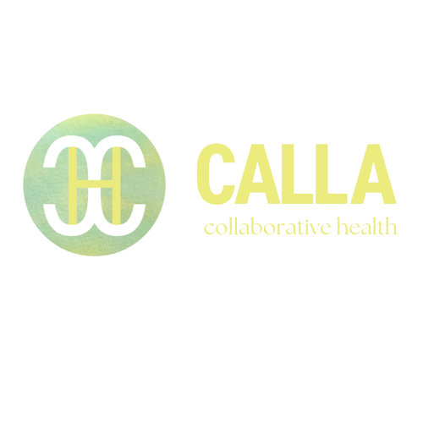

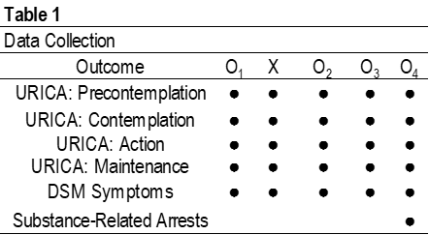
Virgil L. Gregory Jr., PhD, MSCR, LCSW, LCAC Lisa Werth, LCSW, LCAC
Associate Professor Clinical Director, Regional Trainer
A Program Evaluation: Synchronous Online Cognitive-Behavioral Intervention
Abstract
Methodology
Results
Secondary Analyses
Interventions are influenced by environmental circumstances. Purpose: The present study
evaluated the effectiveness of an online synchronous cognitive-behavioral intervention for clients who are court-ordered or otherwise mandated. Method: A pre-experimental design was used. Results: Some significant improvements in motivation, substance use symptoms, and arrests. Conclusion: Randomized controlled trials are now needed to examine the efficacy of the intervention.
Ethics: The study was approved by a university institutional review board (IRB).
Sample:
N = 41
Gender: 85% Male, 15% Female
Race: Non-White: 17%, 80% White,
Ethnicity: Hispanic: 7%, Non-Hispanic: 93%
Cognitive-Behavioral Intervention: 8-Hour: 63%, 12-Hour: 37%
Referral Source: Courts: 66%, University: 33%
Age (Years): Mean: 25.1, Standard Deviation: 11.26
Substance Use Symptoms
At 12-month follow-up the participants reported significantly less DSM-5 alcohol or cannabis symptoms relative to the baseline (t = 4.68, df = 29, p < .001) and this difference was large (Hedges’ g = .84, 95% CI: 0.42, 1.26).
Incarceration
all denied having been arrested following the SOC-BGI. External validation via searching county level court records showed no arrest for the 30 participants (n = 30)
Online Synchronous Cognitive-Behavioral Group Intervention
Primary Analysis
Introduction
Conclusion
There are many stakeholders with substantive investments in the outcomes of court-ordered and other mandated substance use intervention. The Covid-19 pandemic has caused many of these treatments to shift to an online synchronous modality. This left questions regarding how effective these interventions are unanswered. The present study represents a pre-experimental evaluation of effectiveness for an online synchronous cognitive-behavioral intervention.
The present study provides preliminary effectiveness for the online synchronous cognitive-behavioral group intervention. More rigorous research is needed
Subgroup Analysis
X₁ – ₄ = URICA Subscales; Y = 8 or 12-Hour Dosage
X₁ = Contemplation (B = -.573, df = 1,p = .05, 95% CI: .34, 1.01)
  8-hour cognitive behavioral dosage had a higher mean (22.92; SD: 2.365) relative to the 12-hour group (22.67; SD: 4.07)
X₂ = Action (B = .745, df = 1, p =.008, 95% CI: 1.22, 3.65)
  12-hour group (mean: 25.40, SD: 2.77) had more motivation for change relative to the 8-hour group (mean: 22.73, SD: 3.19)
Statistical Methods
Reference:
Gregory, V. L., Jr., & Werth, L. (2022). Synchronous online cognitive-behavioral group intervention: 12-month evaluation for substance use mandated clients. Research on Social Work Practice, 32 (8), 940 – 951. https://doi.org/10.1177/10497315221106785
Linear Mixed Modeling:
Comparisons between Compound Symmetry, Autoregressive 1, & Compound Symmetry Heterogenous
Bonferroni Adjustments for multiple tests and outcomes
Pairwise Comparison Effect Size Hedge’s g

